Slide 1
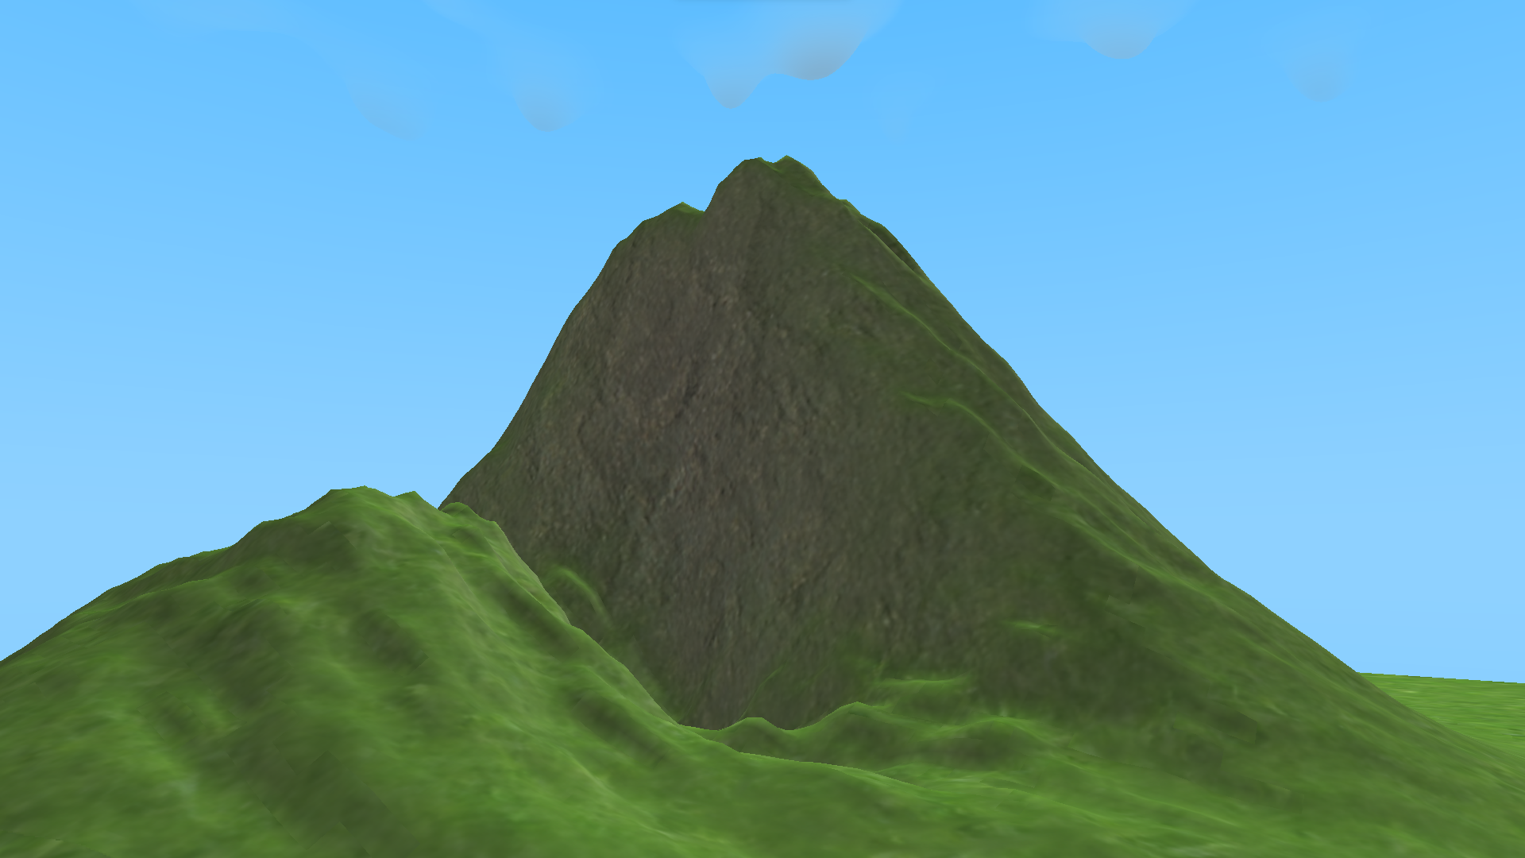
Pycraft
Play
Credits
Settings
Achievements
Character Customisation

Slide 2
Pycraft
Play
Credits
Settings
Achievements
Character Customisation

Slide 3

Pycraft
Play
Credits
Settings
Achievements
Character Customisation

Slide 4
Pycraft
Play
Credits
Settings
Achievements
Character Customisation

Slide 5

Pycraft

